Slide 1

STOCK
INVENTORY
COMPUTER SCIENCE & ENGINEERING
TEAM MEMBERS:
BALAJI.T (421320104004)
NAVEEN.N (421320104021)
RAGESH.V (421320104030)
YUVARAJ KRISHNAN.D (421320104051)

Slide 2
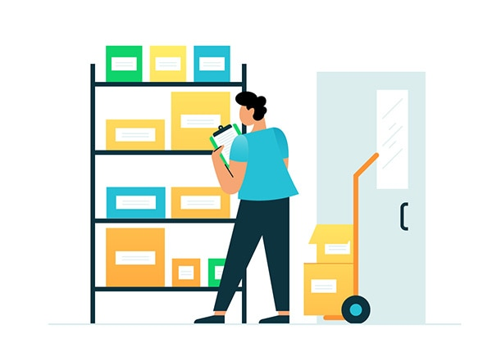
INTRODUCTION
Inventory management refers to the process of ordering, storing, using, and selling a company's inventory. This includes the management of raw materials, components, and finished products, as well as warehousing and processing of such items. There are different types of inventory management, each with its pros and cons, depending on a company’s needs.

Slide 3
PURPOSE
The main purpose of inventory management is to help businesses easily and efficiently manage the ordering, stocking, storing, and using of inventory. By effectively managing your inventory, you’ll always know what items are in stock, how many of them there are, and where they are located.
You can zero in on exactly what you need, what’s not so important, and what’s just a waste of money. That’s using inventory management to practice inventory control. By the way, inventory control is the balancing act of always having enough stock to meet demand, while spending as little as possible on ordering and carrying inventory.

Slide 4
SOFTWARE REQUIREMENTS
Frontend:
HTML
CSS
JAVASCRIPT
REACTJS
Backend:
JAVA
MySQL

Slide 5
HARDWARE REQUIREMENT
Laptop or PC
Processor- Intel i3 based or higher
RAM- 8GB or higher
Hard Disk- 10GB or higher

Slide 6
Functional requirements
1. Inventory Management:The system should allow users to add, update, and delete stock items, including details like product name, description, quantity, unit price, and category.
2. User Authentication: Secure login and role-based access to ensure that only authorized personnel can make changes or access sensitive data.
3. Inventory Tracking: Real-time tracking of stock levels, with notifications or alerts when items are low in stock.
4. Barcode Scanning: Support for barcode scanning to speed up the process of adding or updating items in the inventory.

Slide 7
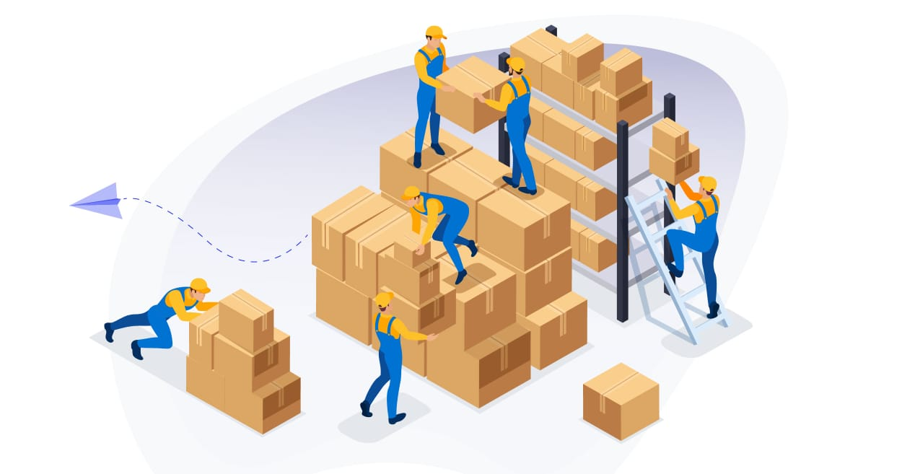
5. Order Management: Create and manage purchase orders, sales orders, and return orders. This should include order status tracking.
6. Reporting and Analytics: Generate various reports, such as inventory valuation, stock turnover, and sales performance.
7. Supplier Management: Maintain information about suppliers, including contact details, terms, and performance history.
8. Customer Management: If applicable, store customer information and track sales to specific customers.
9. Multi-location Support: If the business operates in multiple locations, the system should support tracking inventory across various locations.
10. Stock Valuation: Calculate the total value of the inventory using methods like FIFO (First-In, First-Out) or LIFO (Last-In, First-Out).

Slide 8
11. Audit Trails: Keep a record of all inventory-related transactions for accountability and auditing purposes.
12. Integration: Ability to integrate with other systems, such as accounting software or point of sale (POS) systems.
13. Forecasting: Predict future inventory needs based on historical data and trends.
14. User-Friendly Interface: Ensure that the system is intuitive and easy for users to navigate.
15. Mobile Accessibility: Provide mobile access for on-the-go inventory management.
16. Data Backup and Recovery: Regularly backup data and have a plan for data recovery in case of system failures.

Slide 9
17. Scalability: The system should be able to handle growing inventory needs and a larger user base.
18. Compliance: Ensure that the system complies with any industry-specific regulations and standards.
19. Security: Implement robust security measures to protect sensitive inventory data.
20. Customization: Allow for customization to adapt to the specific needs of the business.

Slide 10
NON-FUNCTIONAL REQUIREMENT
1. Performance:
Response Time: The system should have low response times for tasks like item lookup, order processing, and reporting.
Scalability: The application must handle increasing data and user loads without significant performance degradation.
Throughput: Support a high number of concurrent users and transactions.

Slide 11
2. Reliability:
Availability: The system should be available 24/7, with minimal downtime for maintenance.
Fault Tolerance: It should be able to handle system failures or errors gracefully without data loss.
Data Integrity: Ensure the accuracy and consistency of data, even during system interruptions.
3. Security:
Data Encryption: Use encryption for data transmission and storage to protect sensitive information.
Access Control: Implement strong user authentication and authorization mechanisms.
Auditing: Log and monitor all access and changes to the inventory system for security auditing.

Slide 12
4. Usability:
User Interface Design: Ensure a user-friendly and intuitive interface to minimize user errors.
Accessibility: Make the application accessible to users with disabilities.
Training and Documentation: Provide training resources and user documentation to help users understand the system.
5. Scalability:
Horizontal Scaling: Design the application to scale horizontally across multiple servers if needed.
Vertical Scaling: Allow for increased resources (CPU, memory, etc.) to handle growing demands.

Slide 13
CONCLUSION
In conclusion, a stock inventory application is a vital tool for businesses of all sizes to effectively manage and track their inventory.
It offers real-time visibility, helps reduce operational costs, minimizes stockouts, and enhances overall efficiency.
With the right features and implementation, it can significantly improve a company's bottom line and customer satisfaction.

Slide 14


